Slide 1



Car Wash location Analysis
Evan Manon

Slide 2
agenda
Chosen location
Population
Income per capita
Annual average daily traffic (aadt)
Demographics
Existing car wash locations
Financial projections

Slide 3
Washington County vs. Tennessee average

Slide 4
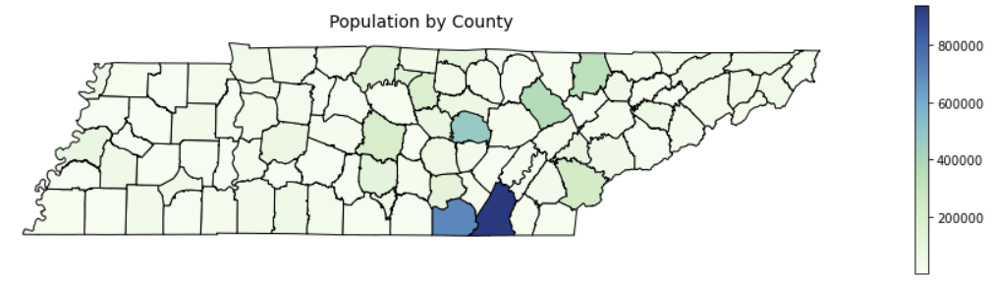
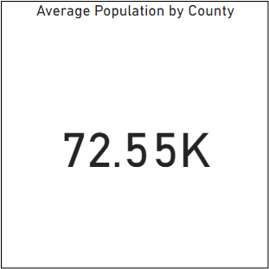
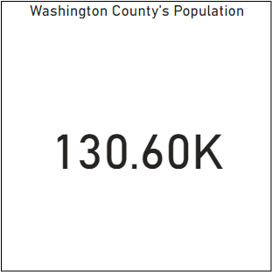
Population
Washington County

Slide 5
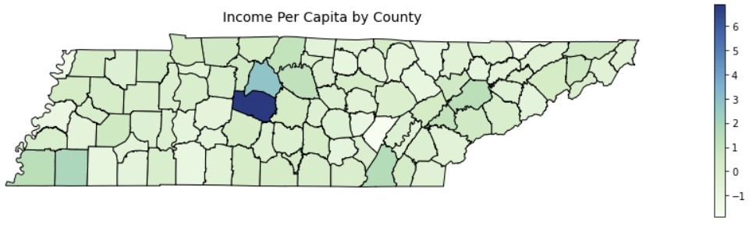
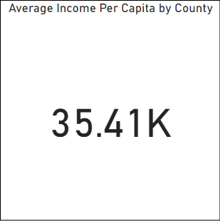
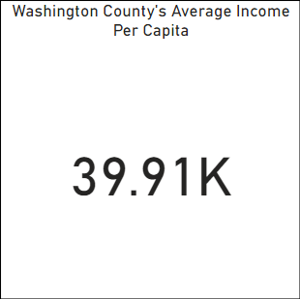
Income per capita
Washington County

Slide 6
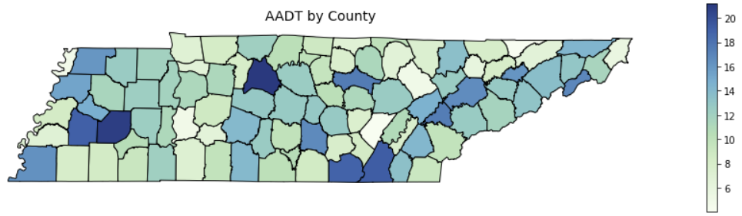
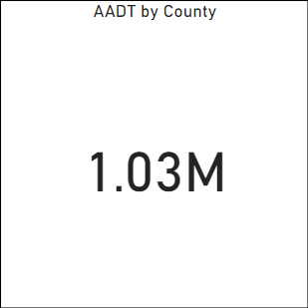
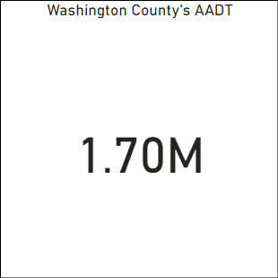
Annual Average Daily Traffic
Washington County

Slide 7
Why Washington county?

Slide 8
car wash key ingredients
Road view commercial real estate
Above average income per capita
aadt of 15,000+
Demand for car wash
Affordable land prices
Higher middle-aged population
Near major intersection

Slide 9
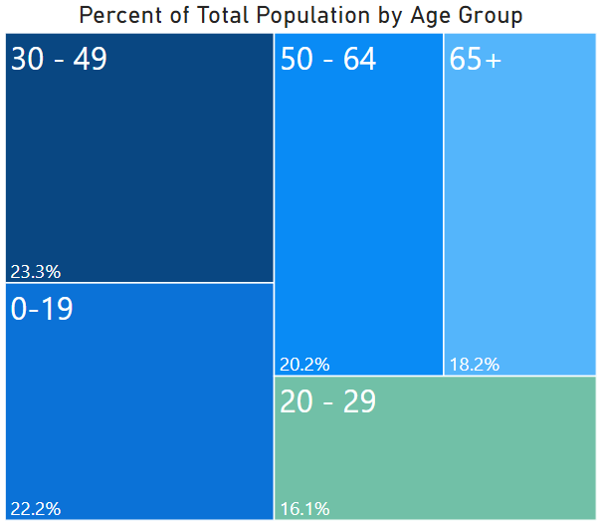
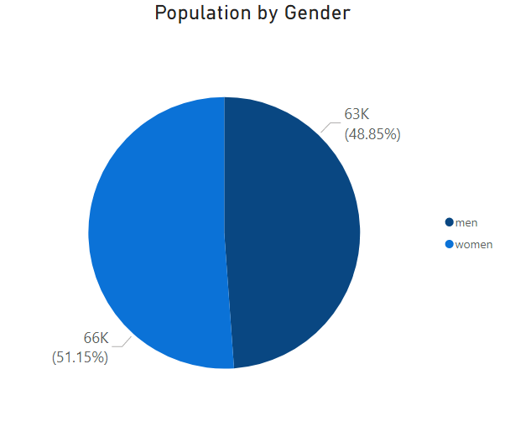
Age/gender demographics

Slide 10

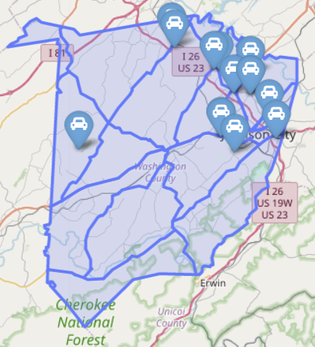
Existing car wash locations
Existing car wash locations (13)
In bay/self service (10)
Tunnel (2)
Mobile (1)

Slide 11
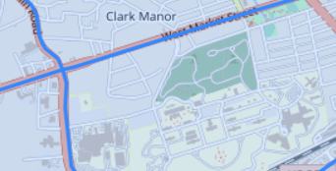
Location strengths
Proposed Car Wash Location
18,510 AADT
Near large intersection
Affordable land
Closest car wash is 2+ miles away
No full-service car washes in area
Road view property

